Slide 1

Chapter 7
Validation Activities
Objectives
Validation is the next step after verification.
Validation is performed largely by black box testing techniques.
Unit validation testing
Integration Testing and its types
Function Testing
System Testing and its types: Recovery testing, Security testing, Stress testing, Performance Testing, Usability testing, Compatibility testing
Acceptance Testing and its types: Alpha and Beta testing

Slide 2
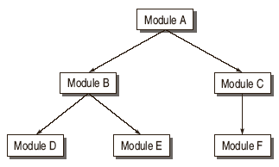
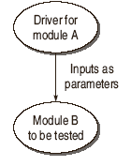
Evolution of Software Testing
Unit Validation Testing
Drivers
a test driver is supporting code and data used to provide an environment for testing part of a system in isolation.
A test driver may take inputs in the following form and call the unit to be tested:
It may hardcode the inputs as parameters of the calling unit.
It may take the inputs from the user.
It may read the inputs from a file.

Slide 3
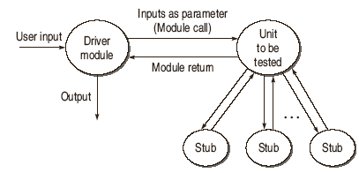
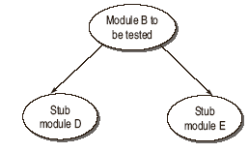
Evolution of Software Testing
Unit Validation Testing
Stubs
  Stub can be defined as a piece of software that works similar to a unit which is referenced by the Unit being tested, but it is much simpler that the actual unit.

Slide 4
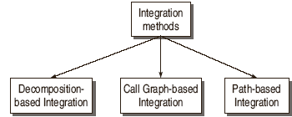
Integration Testing
Integration testing exposes inconsistency between the modules such as improper call or return sequences.
Data can be lost across an interface.
One module when combined with another module may not give the desired result.
Data types and their valid ranges may mismatch between the modules.

Slide 5
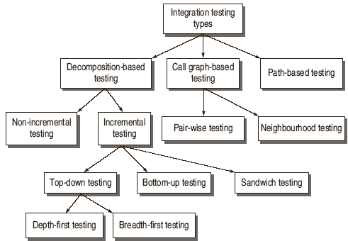
Decomposition Based Integration

Slide 6
Integration Testing

Slide 7
Practical Approach for Integration Testing
There is no single strategy adopted for industry practice.
For integrating the modules, one cannot rely on a single strategy. There are situations depending upon the project in hand which will force to integrate the modules by combining top-down and bottom-up techniques.
This combined approach is sometimes known as Sandwich Integration testing.
The practical approach for adopting sandwich testing is driven by the following factors:
Priority
Availability

Slide 8
Software Testing Myths
Decomposition based integration testing
The integration testing effort is computed as number of test sessions. A test session is one set of test cases for a specific configuration. The total test sessions in decomposition based integration is computed as:
Number of test sessions = nodes – leaves + edges

Slide 9
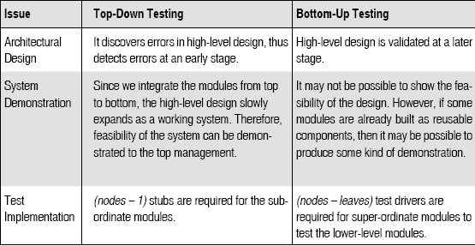
Incremental Integration Testing

Slide 10
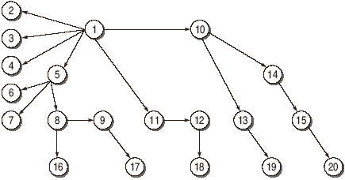
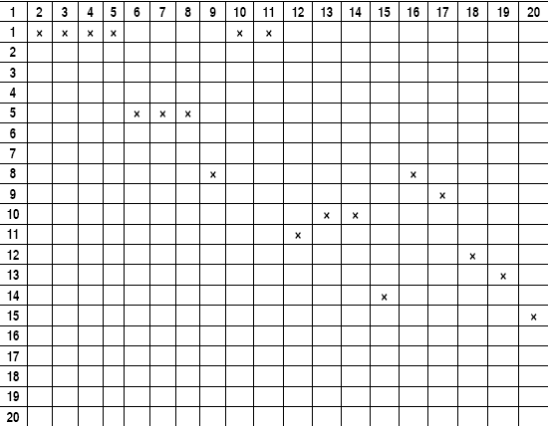
Call Graph Based Integration
A call graph is a directed graph wherein nodes are modules or units and a directed edge from one node to another node means one module has called another module. The call graph can be captured in a matrix form which is known as adjacency matrix.

Slide 11
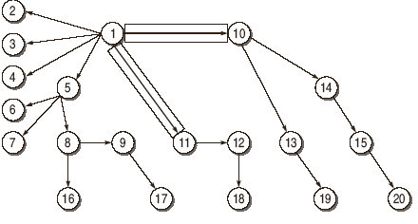
Pair-wise Integration

Slide 12
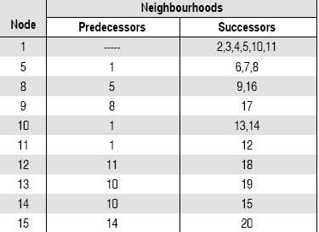
Neighborhood Integration
The total test sessions in neighborhood integration can be calculated as:
Neighborhoods = nodes – sink nodes
= 20 - 10
= 10
where Sink Node is an instruction in a module at which execution terminates.

Slide 13
Path Based Integration
Source Node
Sink Node
Module Execution Path (MEP) Message
MM-Path
MM-Path Graph

Slide 14
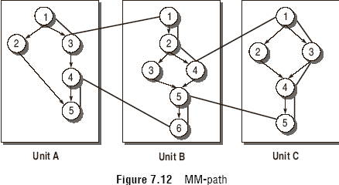
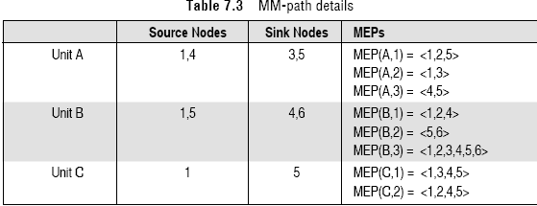
Path Based Integration

Slide 15
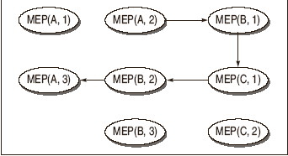
Path Based Integration

Slide 16
Function Testing
The process of attempting to detect discrepancies between the functional specifications of a software and its actual behavior.
The function test must determine if each component or business event:
  performs in accordance to the specifications,
  responds correctly to all conditions that may be presented by incoming events / data,
  moves data correctly from one business event to the next (including data stores), and
  business events are initiated in the order required to meet the business objectives of the system.

Slide 17
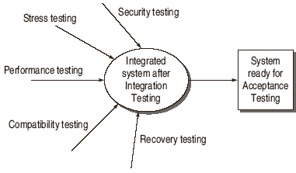
System Testing

Slide 18
Recovery Testing
Recovery is just like the exception handling feature in a programming language.
Recovery is the ability of a system to restart operations after the integrity of the application has been lost.
It reverts to a point where the system was functioning correctly and then reprocesses the transactions up until the point of failure Some

Slide 19
Security Testing
Confidentiality
Integrity
Authentication
Authorization
Availability
Non-repudiation

Slide 20
Performance Testing
The performance testing requires that performance requirements must be clearly mentioned in SRS and system test plans.
The main thing is that these requirements must be quantified.
For example, a requirement that the system return a response to a query in a reasonable amount is not an acceptable requirement; the time must be specified in a quantitative way.
Load Testing
Stress Testing

Slide 21
Usability Testing
Ease of Use
Interface steps
Response Time
Help System
Error Messages

Slide 22
Compatibility/Conversion/Configuration Testing
Operating systems: The specifications must state all the targeted end-user operating systems on which the system being developed will be run.
Software/ Hardware: The product may need to operate with certain versions of web browsers, with hardware devices such as printers, or with other software, such as virus scanners or word processors.
Conversion Testing
Ranking of possible configurations: Identification of test cases:
Updating the compatibility test cases

Slide 23
Acceptance Testing
Acceptance Testing is the formal testing conducted to determine whether a software system satisfies its acceptance criteria and to enable buyer to determine whether to accept the system or not.
Determine whether the software is fit for the user to use.
Making users confident about product
Determine whether a software system satisfies its acceptance criteria.
Enable the buyer to determine whether to accept the system.
Alpha Testing Beta Testing

